Slide 1

Sentiment Analysis: Decoding Customer Emotions
This presentation explores a sentiment analysis project using machine learning. We'll dissect the code, examine key steps, and reveal insights into customer sentiment classification.

Slide 2

Data Preparation and Cleaning
1
Load and Deduplicate
Import CSV data and remove duplicate entries to ensure data integrity.
2
Text Preprocessing
Clean text by removing HTML tags, expanding contractions, and eliminating non-alphabetic characters.
3
Tokenization and Lemmatization
Break text into tokens and reduce words to their base form.
4
Stop Word Removal
Eliminate common words that don't contribute to sentiment analysis.

Slide 3
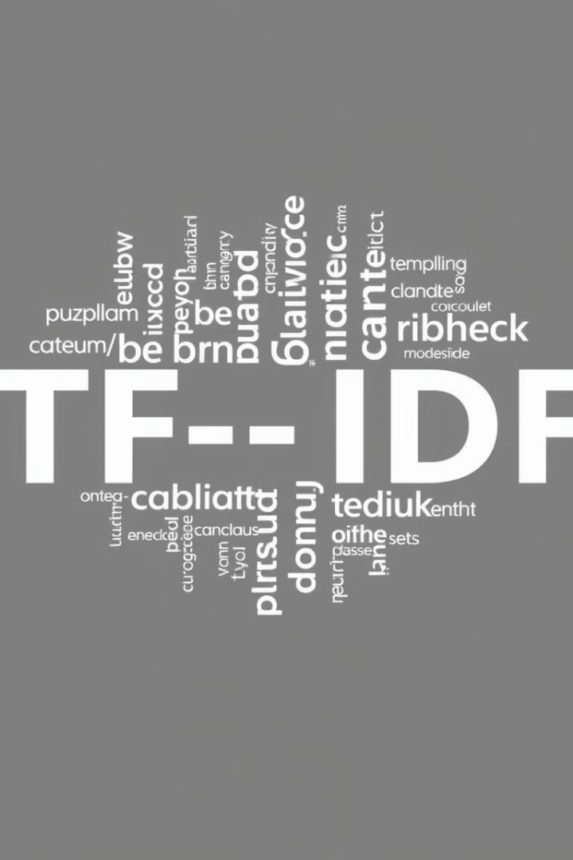
Feature Extraction with TF-IDF
TfidfVectorizer
Convert text data into numerical features using term frequency-inverse document frequency.
N-grams
Capture phrases up to 3 words long for more context.
Max Features
Limit to 5000 most important features to balance information and computation.
Sparse Matrix
Create a compact representation of text data for efficient processing.

Slide 4
Naive Bayes Classification
Gaussian Naive Bayes
Training Process
Prediction
Probabilistic classifier based on Bayes' theorem with independence assumptions between features.
Split data into training and testing sets (80/20 ratio).
Apply the trained model to classify new reviews as positive or negative.
Fit the model on training data to learn feature probabilities.
Utilizes learned probabilities to make sentiment predictions.
Efficient for high-dimensional data like text classification problems.

Slide 5

Model Evaluation Metrics
Metric
Description
Importance
Precision
Ratio of correct positive predictions to total positive predictions
High
Recall
Ratio of correct positive predictions to all actual positives
High
F1-score
Harmonic mean of precision and recall
Very High
Accuracy
Ratio of correct predictions to total predictions
Medium

Slide 6
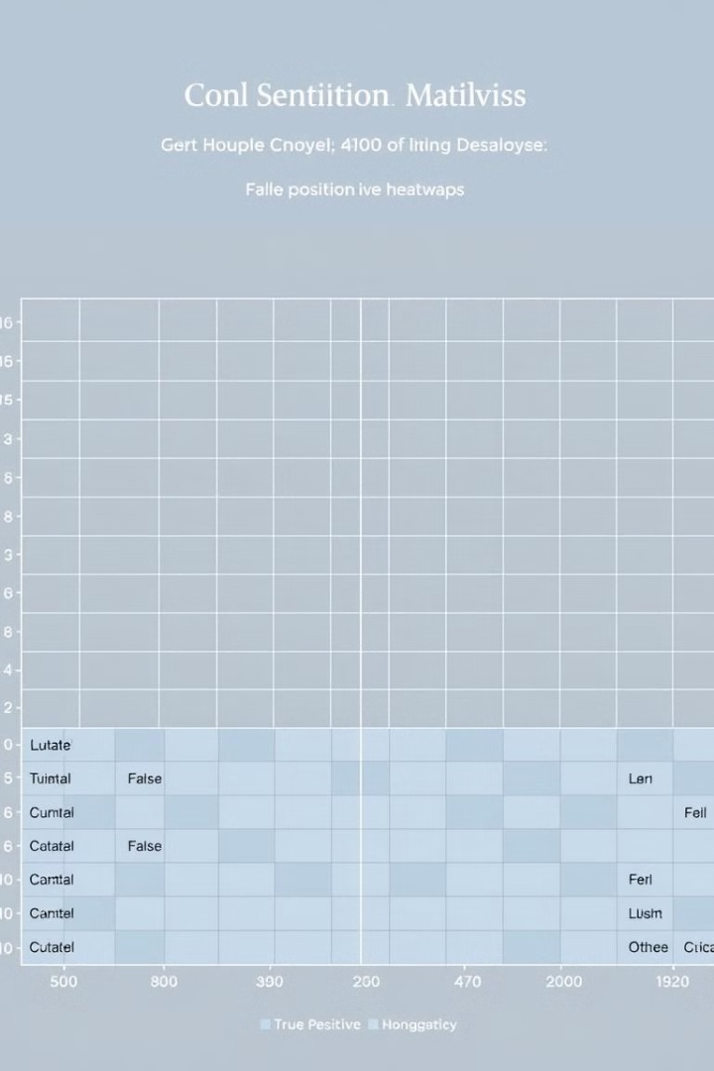
Confusion Matrix Visualization
1
Visual Representation
Heatmap showing the model's prediction performance across different classes.
2
True Positives and Negatives
Diagonal elements represent correctly classified instances for each sentiment.
3
False Positives and Negatives
Off-diagonal elements show misclassifications, helping identify areas for improvement.
4
Color Intensity
Darker colors indicate higher frequency of predictions in each category.

Slide 7





Real-time Sentiment Prediction
User Input
Collect a new review from the user via command-line interface.
Preprocessing
Clean and transform the input using the same steps as training data.
Vectorization
Convert preprocessed text to TF-IDF vector using fitted vectorizer.
Prediction
Apply trained Naive Bayes model to classify sentiment as positive or negative.

Slide 8





Future Enhancements
Larger Dataset
Incorporate more diverse reviews to improve model generalization and accuracy.
Advanced Models
Experiment with deep learning models like LSTM or BERT for potentially better performance.
Fine-grained Analysis
Extend beyond binary classification to multi-class sentiment levels or aspect-based analysis.
Deployment
Develop a web application or API for easy integration with other systems.

